Slide 1
ZOMATO RESTURANT ANALYSIS
Ankita Roy 08-10-2024

Slide 2
PROBLEM STATEMENT:
Identify countries and cities with lower competition but good customer engagement and high ratings.
Identify the count of restaurants in different countries/cities growth per year to understand market trends.
Develop strategies that align pricing with customer preferences while ensuring profitability.
Prioritize online delivery and table booking based on customer demand and feedback.
Tailor menu options to include top-performing cuisines that are highly rated.

Slide 3
DATA DESCRIPTION:
The dataset consists of restaurant-related information, containing various attributes that describe the restaurants, their location, cuisine, customer engagement
The data is organized into two tables:
Restaurant Data Main Table with 20 attributes
Country Description Table with 2 attributes
The popular attributes used to derived insights for expansion and opening restaurants are:
Country
City
Restaurants Name
Average cost for two
Votes/Rating by customers
Cuisines
Year
A few missing values found which were filled based on upward/nearby data for consistency.
Performed various lookup and aggregation functions, conditional formatting, pivot tables and visualization tools to generate key findings.

Slide 4
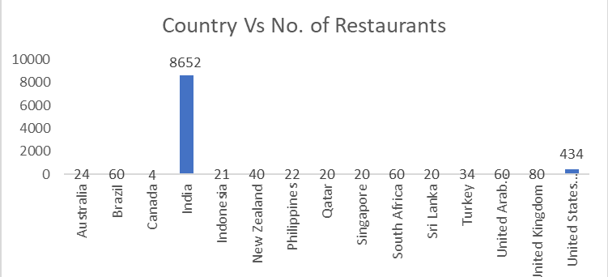
Key Insights:
Number of Restaurants by Country:
Focus on entering markets where the number of competitors is low. For example, Australia, Canada, Qatar, Singapore and Sri Lanka could be prime targets for expansion as they have fewer restaurants and less competition.

Slide 5
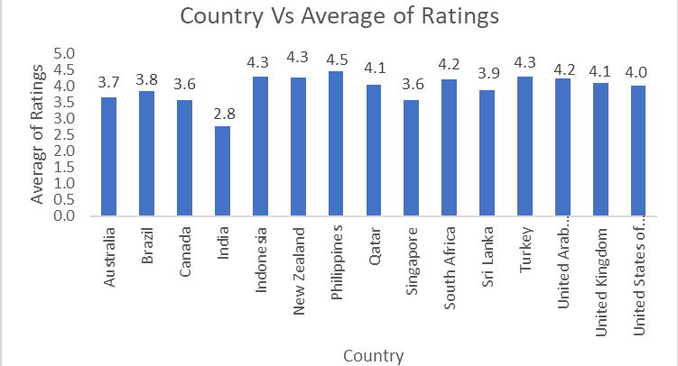

Quality of restaurant ratings in the recommended countries:
The average ratings in the recommended countries Australia, Canada, Qatar, Singapore and Sri Lanka are generally between 3 to 4. This indicates that despite having fewer restaurants, the quality of ratings is satisfactory which is suggesting a demand for more options.
08

Slide 6
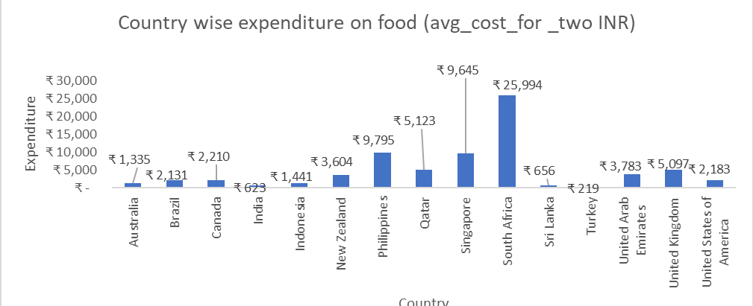
Expenditure on food in the suggested countries:
Looking at the expenditure on food in Australia and Canada falls under mid-range to premium dining. Where as Qatar and Singapore with luxury experiences and Sri Lanka, concentrate on affordable and casual dining options.

Slide 7
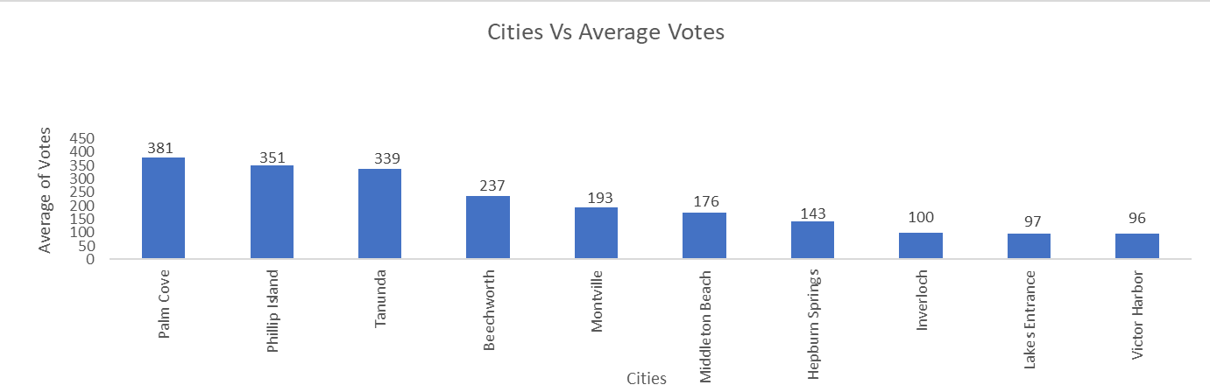
City wise Average Votes :
Based on the average votes i.e. 1 5 7, will focus on the cities where the average votes are near or above 15 6 which helps to identify prime areas for growth and marketing initiatives. Below are suggested cities for new restaurant openings:
Australia: Palm Cove, Phillip Island, Tanunda, Beechworth, Montville, Middleton Beach, Hepburn Springs and Inverloch
Canada: Vineland Station and Chatham-Kent
Qatar: Doha
Singapore: Singapore
Sri Lanka: Colombo

Slide 8
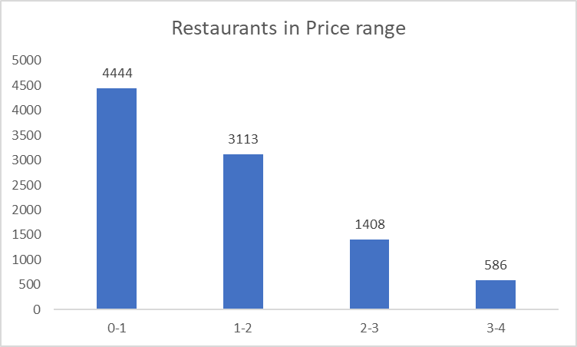
Restaurants in different price range:
The distribution of restaurants by price range reveal customer spending behavior in each country. Here we can see the high number of restaurants in lower price ranges suggests a strong demand for affordable dining options.

Slide 9
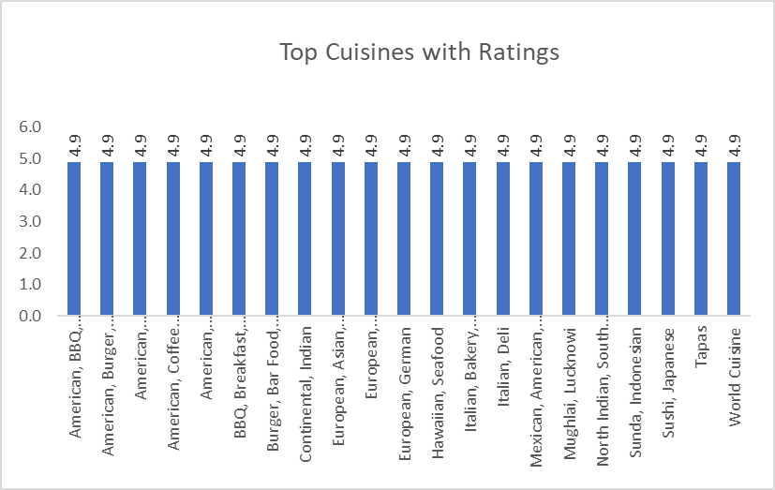
Top Cuisines Analysis:
American, BBQ, Sandwich, Burger, Grill, Caribbean, Seafood, Coffee, Tea, Breakfast, Southern, Burger, Bar Food, Steak, Continental, Indian, European, Asian, Contemporary, German, Hawaiian, Seafood, Italian, Deli, Lucknowi North Indian, South Indian, Mughlai are the top-rated cuisines across countries.

Slide 10
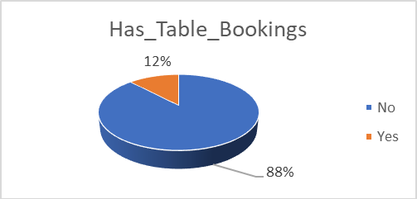
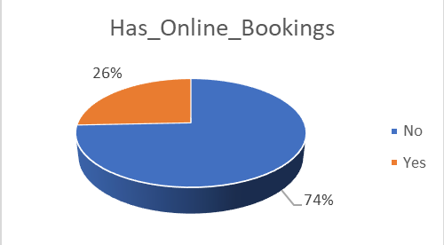
Online delivery and table booking services:
Out of total bookings, table bookings is 12 % and Online booking is 26%. Therefore, online bookings are over twice to table bookings.
Focus on improving and expanding the online booking system by including the mobile app development or integration with popular platforms.
Also, majority of the people do not engage in either of them. Hence by gathering feedback from customers for both to optimize booking process.

Slide 11
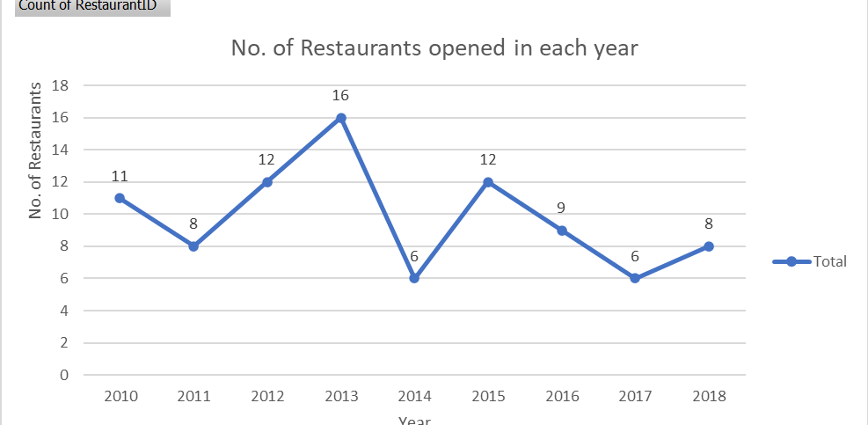
Number of Restaurants Opened Each Year:
Showing an unstable growth pattern, 2013 and 2015 are the highest and others are relatively flat. Therefore, expand in countries or regions where the trend shows growth, indicating a positive demand for new restaurants.

Slide 12
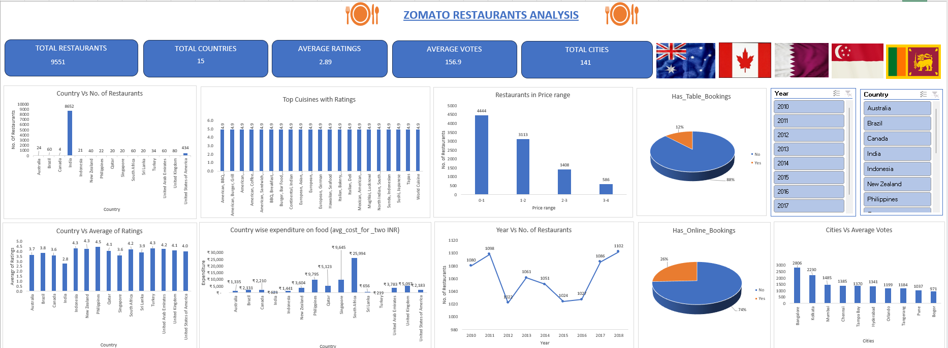
Dashboard:

Slide 13
Recommendations:
Australia, Canada, Qatar, Singapore, and Sri Lanka should be prioritized for expansion as they have fewer restaurants and less competition, providing an opportunity for market dominance.
Target cities like Palm Cove, Phillip Island, Beechworth, Vineland Station, Chatham-Kent, Colombo, and Doha for new restaurant openings, as they show significant growth potential based on average votes .
In Australia and Canada, focus on mid-range to premium dining, as people tend to spend more on meals. where as in Qatar and Singapore, target luxury dining for high-end customers and in Sri Lanka, prioritize affordable and casual dining.
The high number of restaurants in the lower price range suggests a strong demand for affordable dining options. In countries like Sri Lanka and certain cities in Australia, promoting budget-friendly restaurants can attract a wider audience.
Focus on expanding and promoting cuisines that are highly rated across the countries. American, BBQ, Indian, Italian, and Asian cuisines should be prioritized, as they are popular in different regions.
Collect customer feedback to improve online and table bookings, making them easier to use and boosting engagement.

Slide 14
Conclusion:
Focusing on mentioned key factors like countries or cities with lesser restaurants and high average ratings/votes, optimizing affordable dining options, top Cuisines and menu expansion and enhancing Online Booking Service, Zomato can further improve its market position and customer satisfaction.
Analysed the above points by using pivot tables and visualizations such as bar charts, line graphs, scatter plots and pie charts.

Slide 15
THANK YOU

